Slide 1
How Electric Vehicles Have Impacted the World
Group One

Slide 2
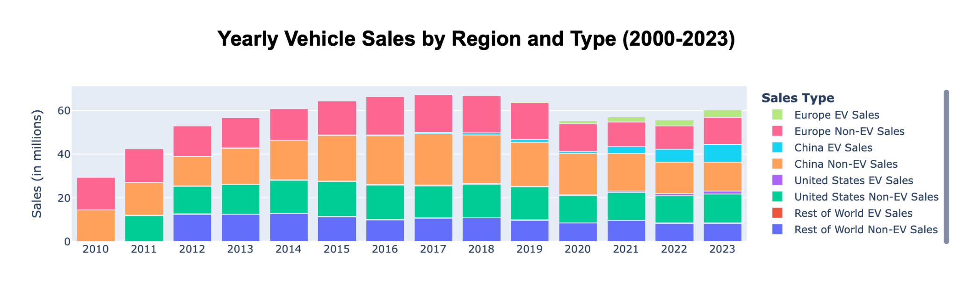
EV Adoption - Global Sales
China leads EV adoption, followed by Europe, the United States, and the Rest of the World, showcasing a global shift towards EVs with varying regional paces.
Notes:
China is the front-runner in EV sales, showcasing a significant move towards electric vehicles, likely driven by governmental policies and incentives.
Europe follows with a steady increase in EV adoption, reflecting environmental policies and growing consumer interest in sustainable transportation.
The United States shows growth in EV sales but at a slower pace, indicating potential barriers such as infrastructure, market readiness, or consumer preferences.
The Rest of the World category indicates minimal EV presence, pointing to possible challenges in EV adoption or data availability.

Slide 3
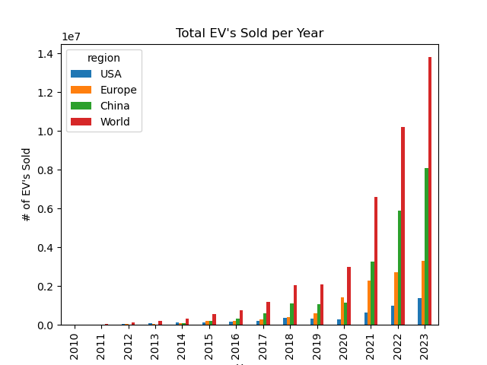
Hypothesis: The # of EV’s sold will have an effect on the number of EV chargers built.
Null Hypothesis: The # of EV’s sold has no effect on the # of EV chargers built.
The number of EV’s sold per year continuous to increase.
As you can see China is leading the race.

Slide 4
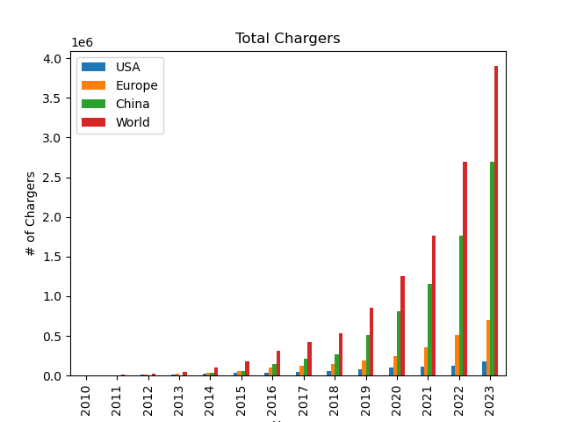
The number of Public EV charging stations also continuous to grow.
China is head and shoulders above the rest of the world.

Slide 5
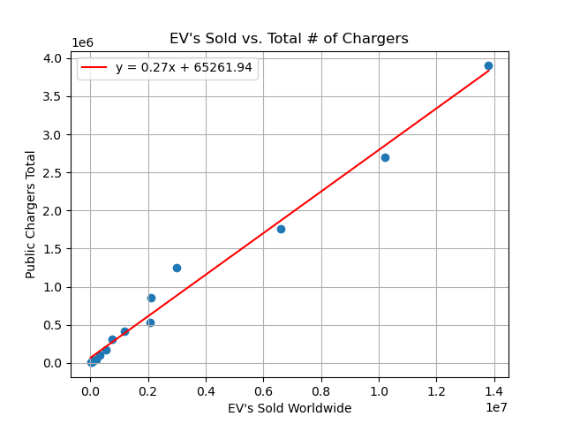
The linear regression model shows that with an increase in EV’s Sold there is a strong positive correlation with the number of EV chargers built.
R^2 value: 0.9854 P value: 2.1804e-12 Std Err : 0.00958
The values show our hypothesis is correct.

Slide 6
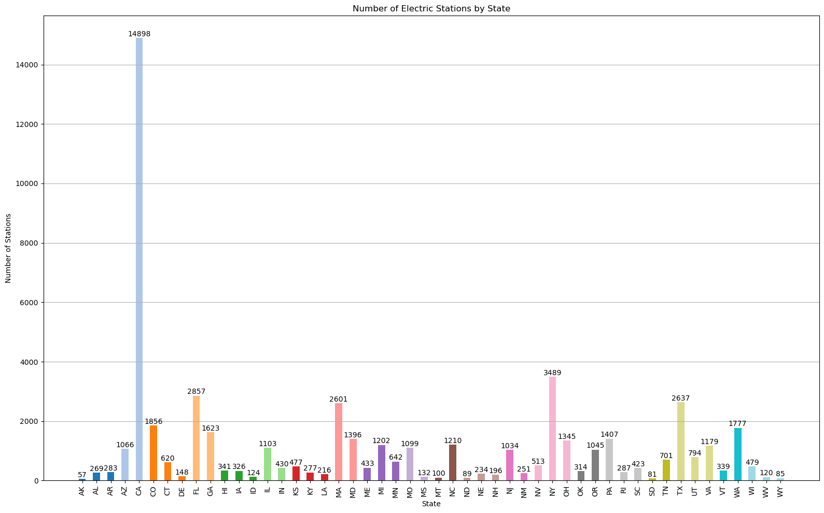
Break down of Charging Station in the US

Slide 7
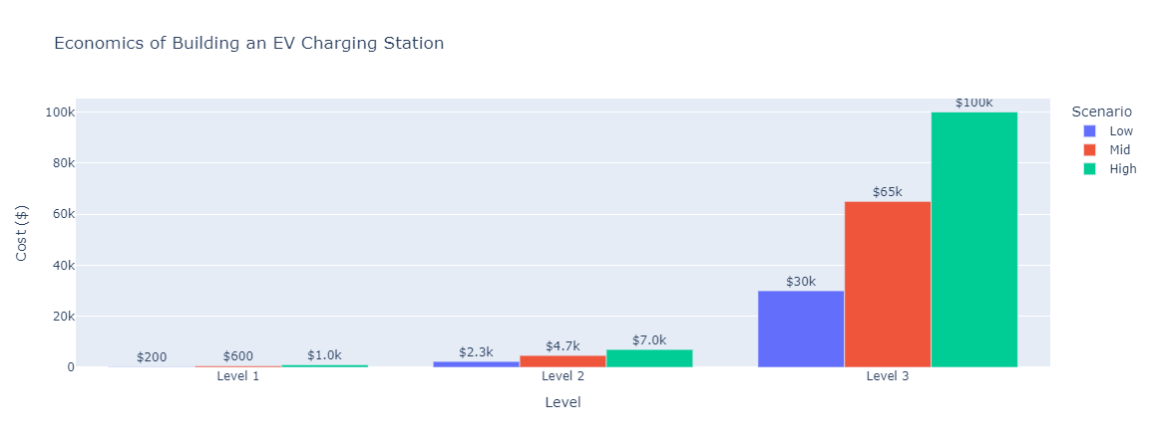
Equipment cost of Level 1, Level 2, Level 3 Charging Stations

Slide 8
Are the number of EV-friendly policies correlated to overall EV sales volume?
Hypothesis: As more EV-friendly policies are announced, the number of EVs sold will increase.
Null Hypothesis: EV-friendly policies have no impact on the number of EVs sold.
Notes:
Start by defining ‘EV policies’ and providing an example of types of categories
Ambition, legislation, proposal, or target announced or enacted by a governmental body (national, state, local)
Target: 30% of new vehicle registrations to be electric by 2030.
Legislation: Rebate towards the purchase or lease of an EV

Slide 9
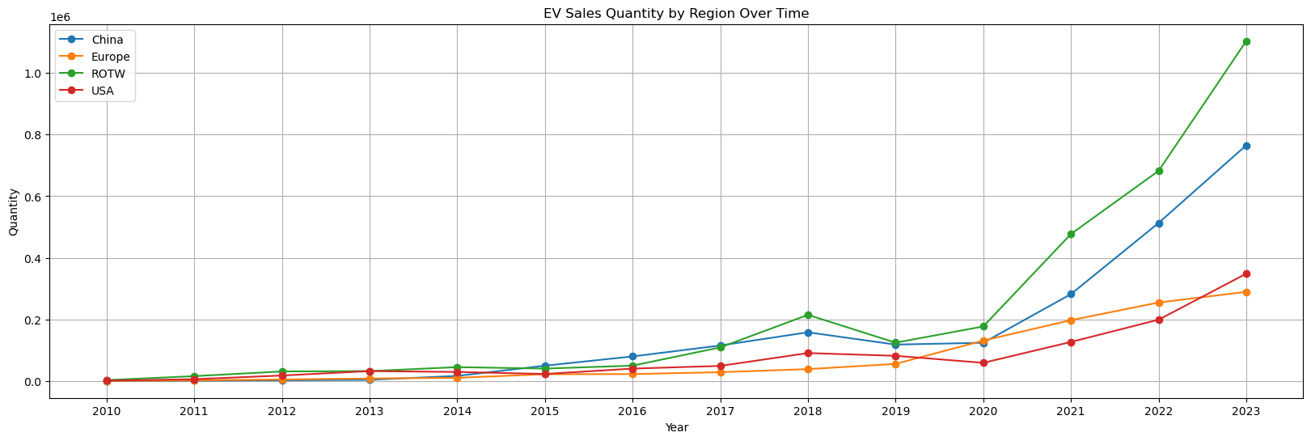
Are the number of EV-friendly policies correlated to overall EV sales volume?
Sales Recap
Globally, there was a sharp increase in sales beginning in 2020 and continuing to 2023.
China and the rest of the world increased the most
Europe’s growth seemed to slow in 2022

Slide 10
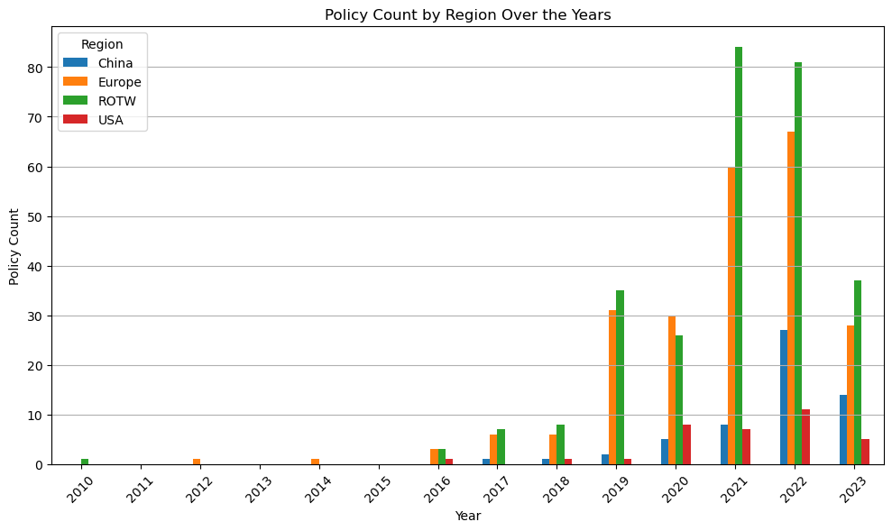
Are the number of EV-friendly policies correlated to overall EV sales volume?
There is an overall positive correlation coefficient = 0.61 and a p-value = 5.88e-7 or 0.000000588
This positive r and low p-value indicate the two variables are positively correlated and we cannot reject the null hypothesis.
It is not an especially strong correlation, however.
Notes:
It is not an especially strong correlation, however. This is evidenced by the fact that new policies declined globally between 2022 and 2023, yet quantity of sales continued to go up.

Slide 11
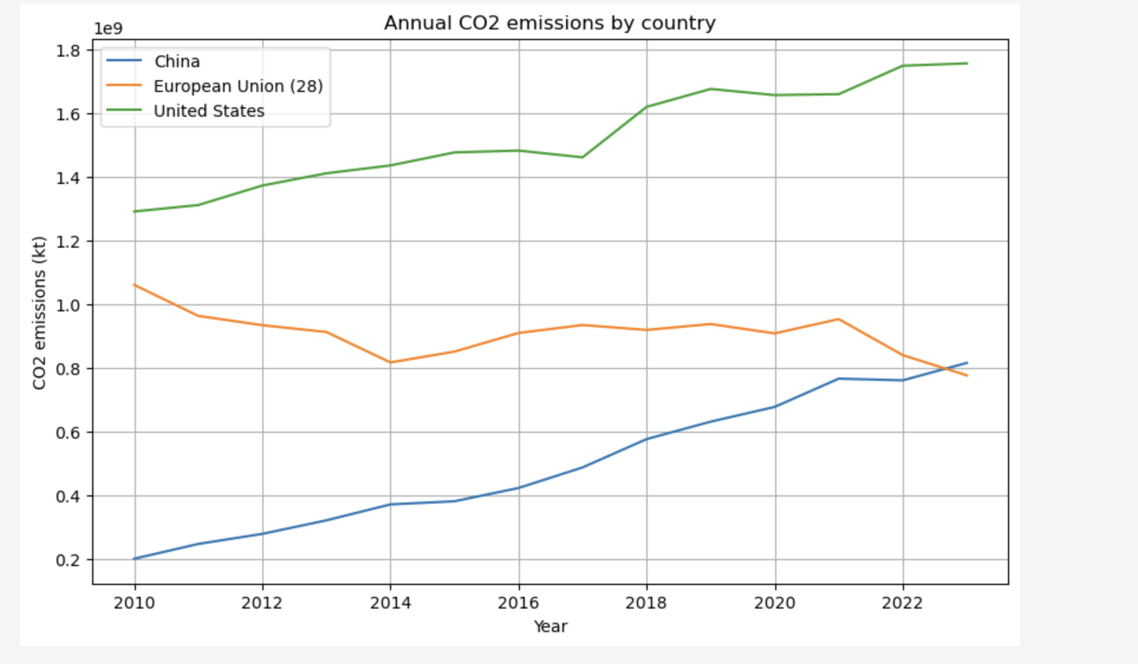
How EVs Have Impacted Global Emissions
EV adoption should reduce emissions but…
Do countries with more incentives have less emissions?
Averages 2010-2024
China
494,560,682
European Union 907,601,449
United States 1,525,155,821

